Slide 1
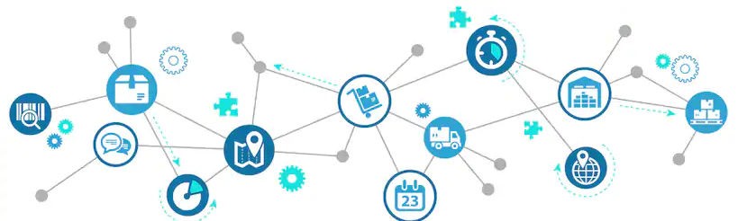
Retail Net

Slide 2

Prepared By :Sanjay Bhagchandani(160260107001)
Rishabh Khale(160260107040)
Kushal Thakar(160260107047)
Guided By : Prof. Shilpa Serasia
Kalol Institute of Technology & Research Centre

Slide 3
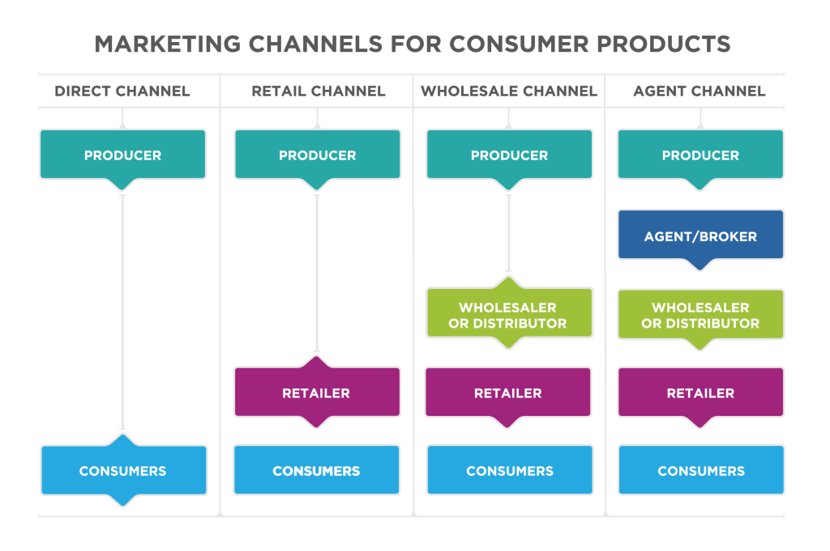

Slide 4
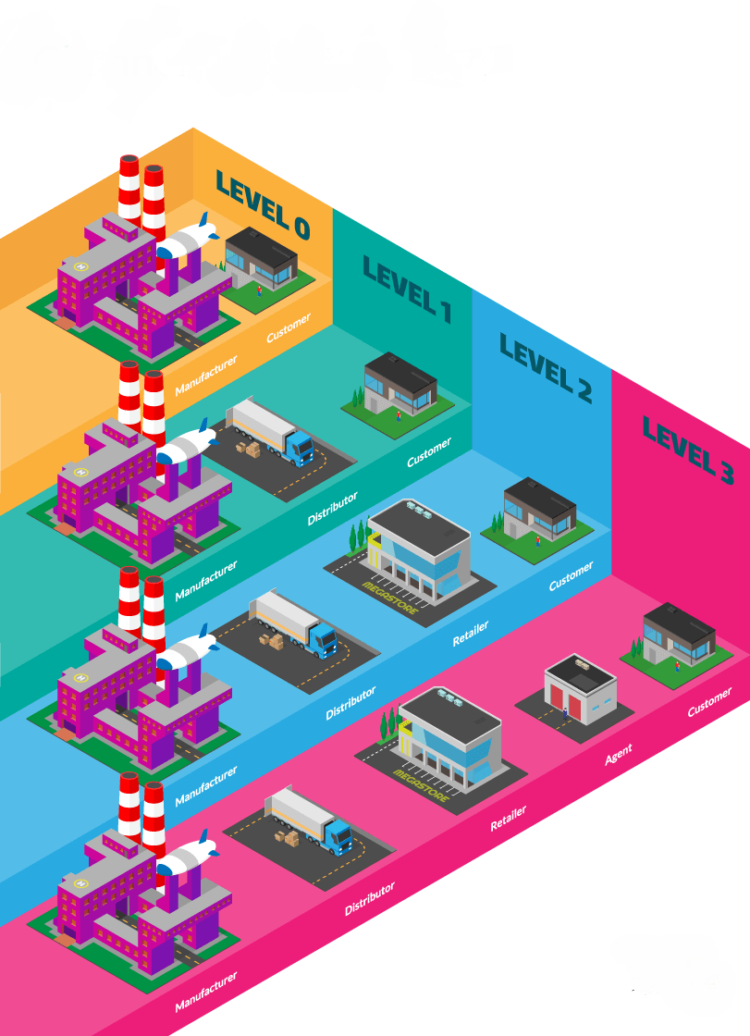
Introduction
E-commerce is an online selling network. This effective way of buying allows the customer to create a bulk order online, this, therefore, cuts out the hassle and is a quicker and easier transaction. Meaning you doesn’t even need reps to sell your product.
“Retail Net” is a web application that provides interacting medium between entities like Manufactures, Whole-sellers, Distributors and Retailers.
“Retail Net” is not for common users(customers ). This is a web application that provides service to business related entities.

Slide 5
Introduction
Using this system entity’s can manage the task of getting the resources or raw materials or product from other entities.
It is a cost and time efficient E-commerce web application which provides the communicating medium between the above mentioned entities.
Details of product will be visible to each entity according to their requirements. Invoice will be generated which can reduce paper work and time

Slide 6
Purpose
The main purpose of using “Retail Net” is that it benefits the business and the customer. The wholesaler can reduce their prices of the products that they sell which will allow the consumer to purchase more stock at a more suitable price. The wholesaler can sell more products at a reduced price but will gain profit from this as it benefits both parties.
Also it cuts out the unwanted wasted time. Without the e-commerce application wholesalers and consumers or any other entity used a paperback catalogue, this wastes time that companies can’t afford. An advantage of using this web application is that it saves time and fuss of visiting the other entities.

Slide 7
Problem Specification
Functional Requirements
A user should be able to filter their requirements related to their needs.
The system shall provide necessary authentication required to verify the user or entity for security reasons.
Every user will have their unique identity.
Entity’s can add or remove their product.
An entity shall be able to search product.
Invoice shall be generated for the entity once the business had taken place.

Slide 8
Non-Functional Requirements
The Web-Application shall be available for businesses related company or stores only.
This Web-Application shall be available anytime and anywhere
Without registration user cannot use this Web-Application.
Purposed System and Target Users:
“Retail Net” is an E-Commerce web application which is used by Manufactures, Whole- sellers, Distributors and Retailers.
This web-app includes features like online ordering, order tracking, invoice generation, product update etc and it also provide security with beautiful interface so that user can easily interact with the web-app.

Slide 9

Tools 🔨
Front-end
- Html
- Css
- Bootstrap
- javascript
Back-end
-Java
-MVC
- Spring
- Hibernate
- Mysql
- Xampp
- Tomcat
- Java lib
- Jsp
- Jsp Taglib

Slide 10
Technology
Java
Java is a general purpose programming language with a number of features that make the language well suited for use on the World Wide Web. Small Java applications are called Java applets and can be downloaded from a Web server and run on your computer by a Java compatible Web browser.
Java source code files (files with a .java extension) are compiled into a format called byte code (files with a .class extension), which can then be executed by a Java interpreter. Compiled Java code can run on most computers because Java interpreters and runtime environments, known as Java Virtual Machines (JVMs).

Slide 11
Literature Review
1. Patent No- US20040034578A1
Accordingly, a better system is disclosed for storing and maintaining a plurality of field orders and a corresponding plurality of invoices. This system allows a supplier and a buyer to easily view and obtain copies of one or more of the field orders and their corresponding invoices when proper security constraints are satisfied.
2. Patent No- US20060136309A1
A comprehensive system effectuates global electronic commerce on the Internet across frontiers of nations, cultures, and languages. Referral Websites serving various locales offer Buyers the opportunity to view products for purchase. A Buyer selects categories of products for viewing by using drop-down menus that organize products into a clear taxonomy that can be expressed across all languages.

Slide 12
3.Patent No- US20030130899A1
A system and method for historical database training of non-linear models for use in electronic commerce. The non-linear model is trained with training sets from a stream of electronic commerce data.
4. Patent No- US20100030662A1
A system enables a customer to order goods via the Internet using a browsing device. The system includes at least one web server.

Slide 13
System Requirement
Hardware Requirements
Ram: Minimum (2GB)
Processor with 2GHz frequency or above
Monitor Resolution 1024 X 768 or higher
Storage of 20GB or more.
Software Requirements
Web Browser
Os: Any Operating System because of java
Internet Connection

Slide 14
Modules and Functionality
Registration: In this module user have to register himself with our web-app.
Login: once users have registered itself they will have their Username and password for login the web-app.
Invoice generation: Invoice is generated once deal is done.
Add/remove Product: Entity’s can add or remove product according to their needs.
Search: Entity can search for relevant product and can get that product at profitable price.

Slide 15
Modules and Functionality
Product Details: Here entity can see the detail of each and every product.
Terms and condition: Policy regarding the web-application
Order Cart: Keeps the detail of the products which user have bought or is willing to buy them.
Above mentioned modules are available for each and every entity like Manufactures, Whole-sellers, Distributors and Retailers.

Slide 16
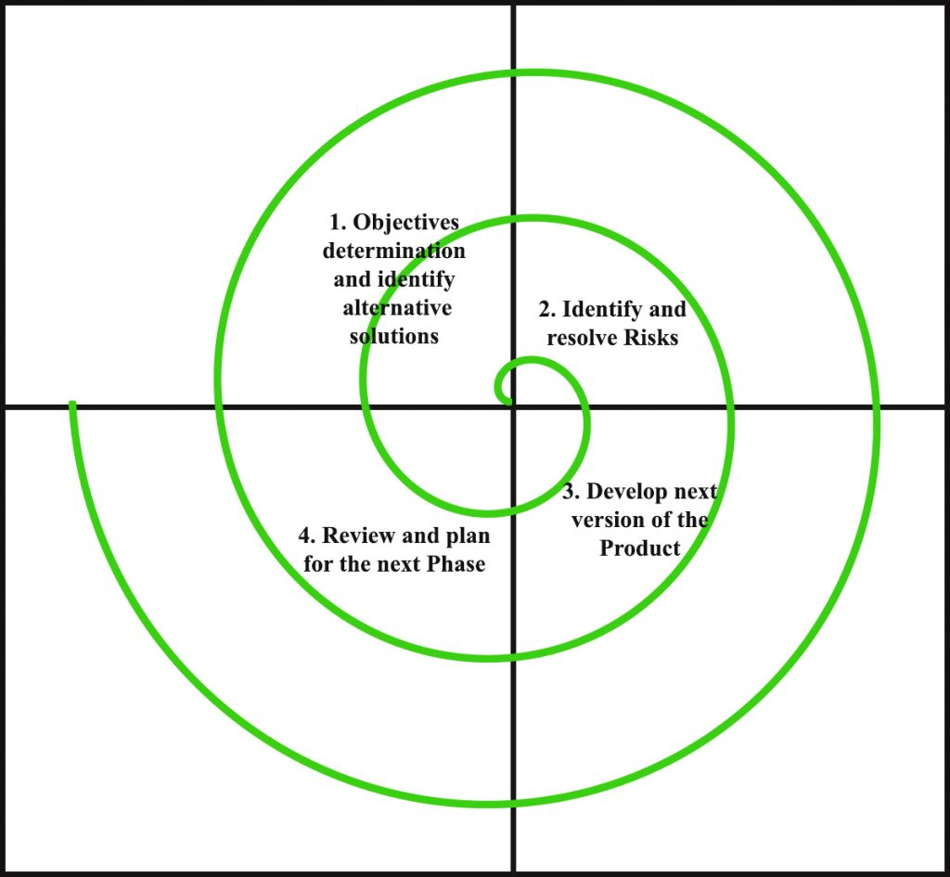
Software Development Model
Design of Spiral model

Slide 17
Advantages of spiral model
High amount of risk analysis hence, avoidance of Risk is enhanced.
Good for large and mission-critical projects.
Strong approval and documentation control.
Additional Functionality can be added at a later date.
Disadvantages of spiral model
Can be a costly model to use.
Risk analysis requires highly specific expertise.
Project’s success is highly dependent on the risk analysis phase.
Doesn’t work well for smaller projects.

Slide 18
When to use spiral model
When costs and risk evaluation is important.
For medium to high-risk projects.
Long-term project commitment unwise because of potential changes to economic priorities.
Users are unsure of their needs.
Requirements are complex.
New product line.
Significant changes are expected (research and exploration).

Slide 19
Gantt Chart

Slide 20
Retail-Net Timeline
2019
Jun
Jul
Aug
Sep
Oct
2019
Today
Feasibility Study
12 days
20 Jun - 5 Jul
Analysis
15 days
8 Jul - 28 Jul
Requirement Gathering
11 days
29 Jul - 12 Aug
100%
Data Dictionary
15 days
15 Jul - 4 Aug
Filling PPR
44 days
15 Jun - 15 Aug
Filling PSAR
42 days
15 Jul - 10 Sep
70%
Diagrams
19 days
15 Sep - 10 Oct
Canvas Making
5 days
2 Oct - 8 Oct
80%
Report
11 days
1 Oct - 15 Oct

Slide 21
Design Engineering Canvas

Slide 22
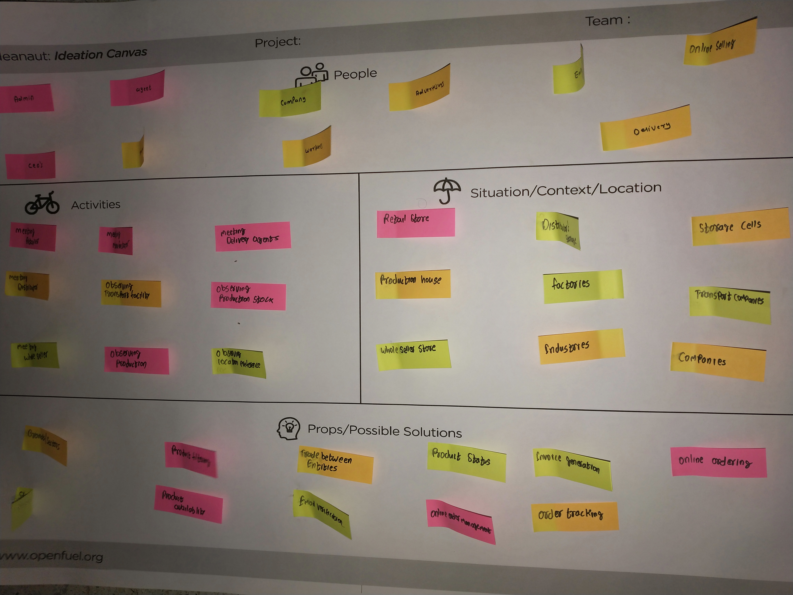
Ideation Canvas

Slide 23
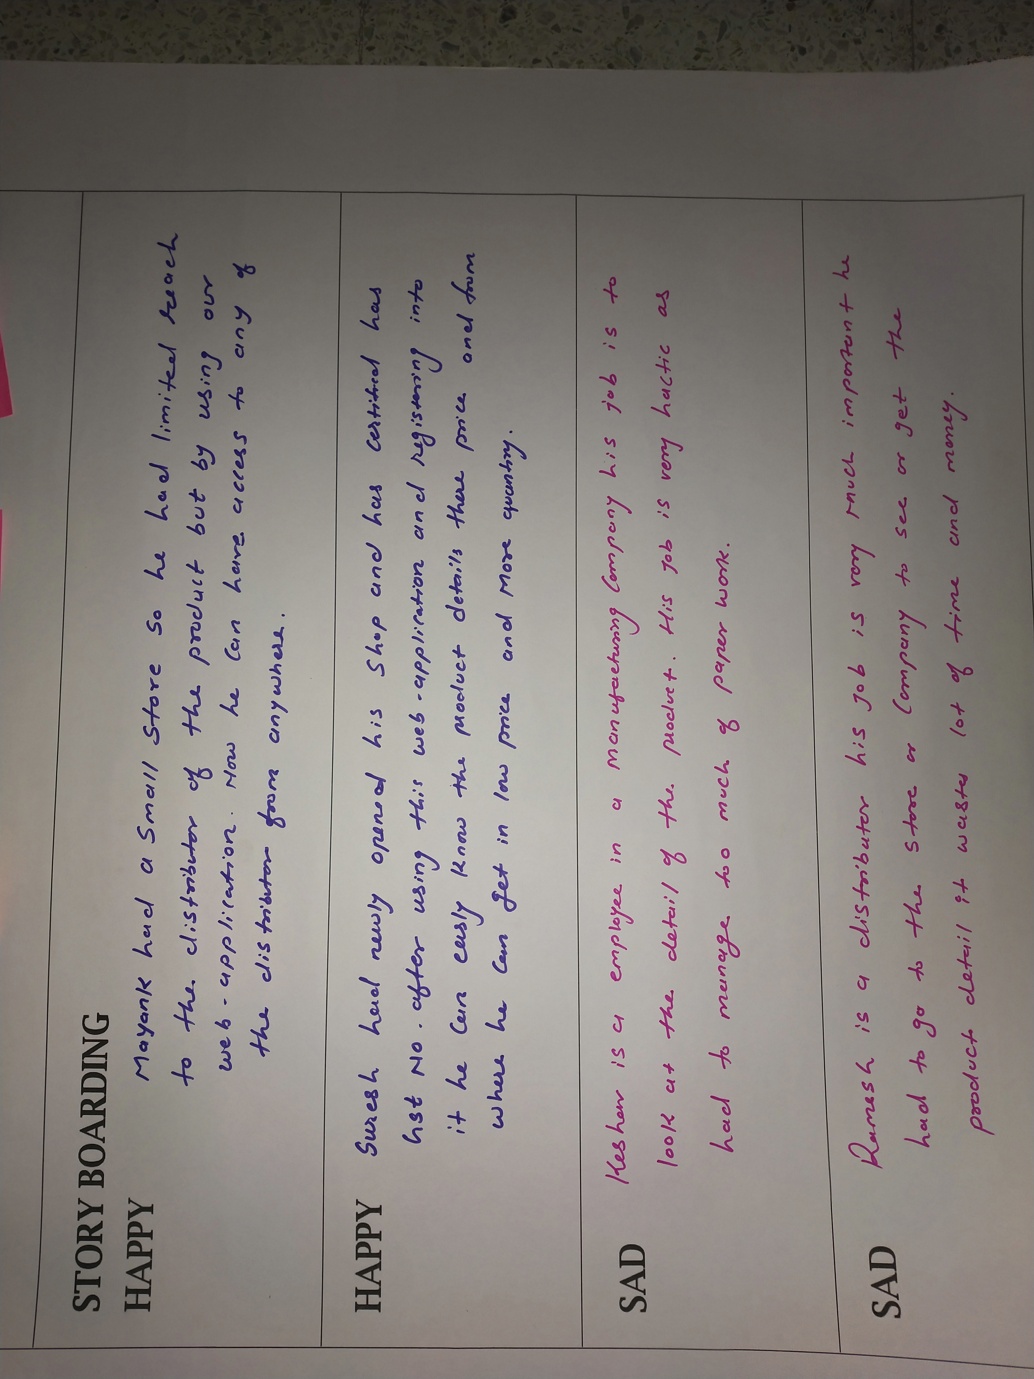
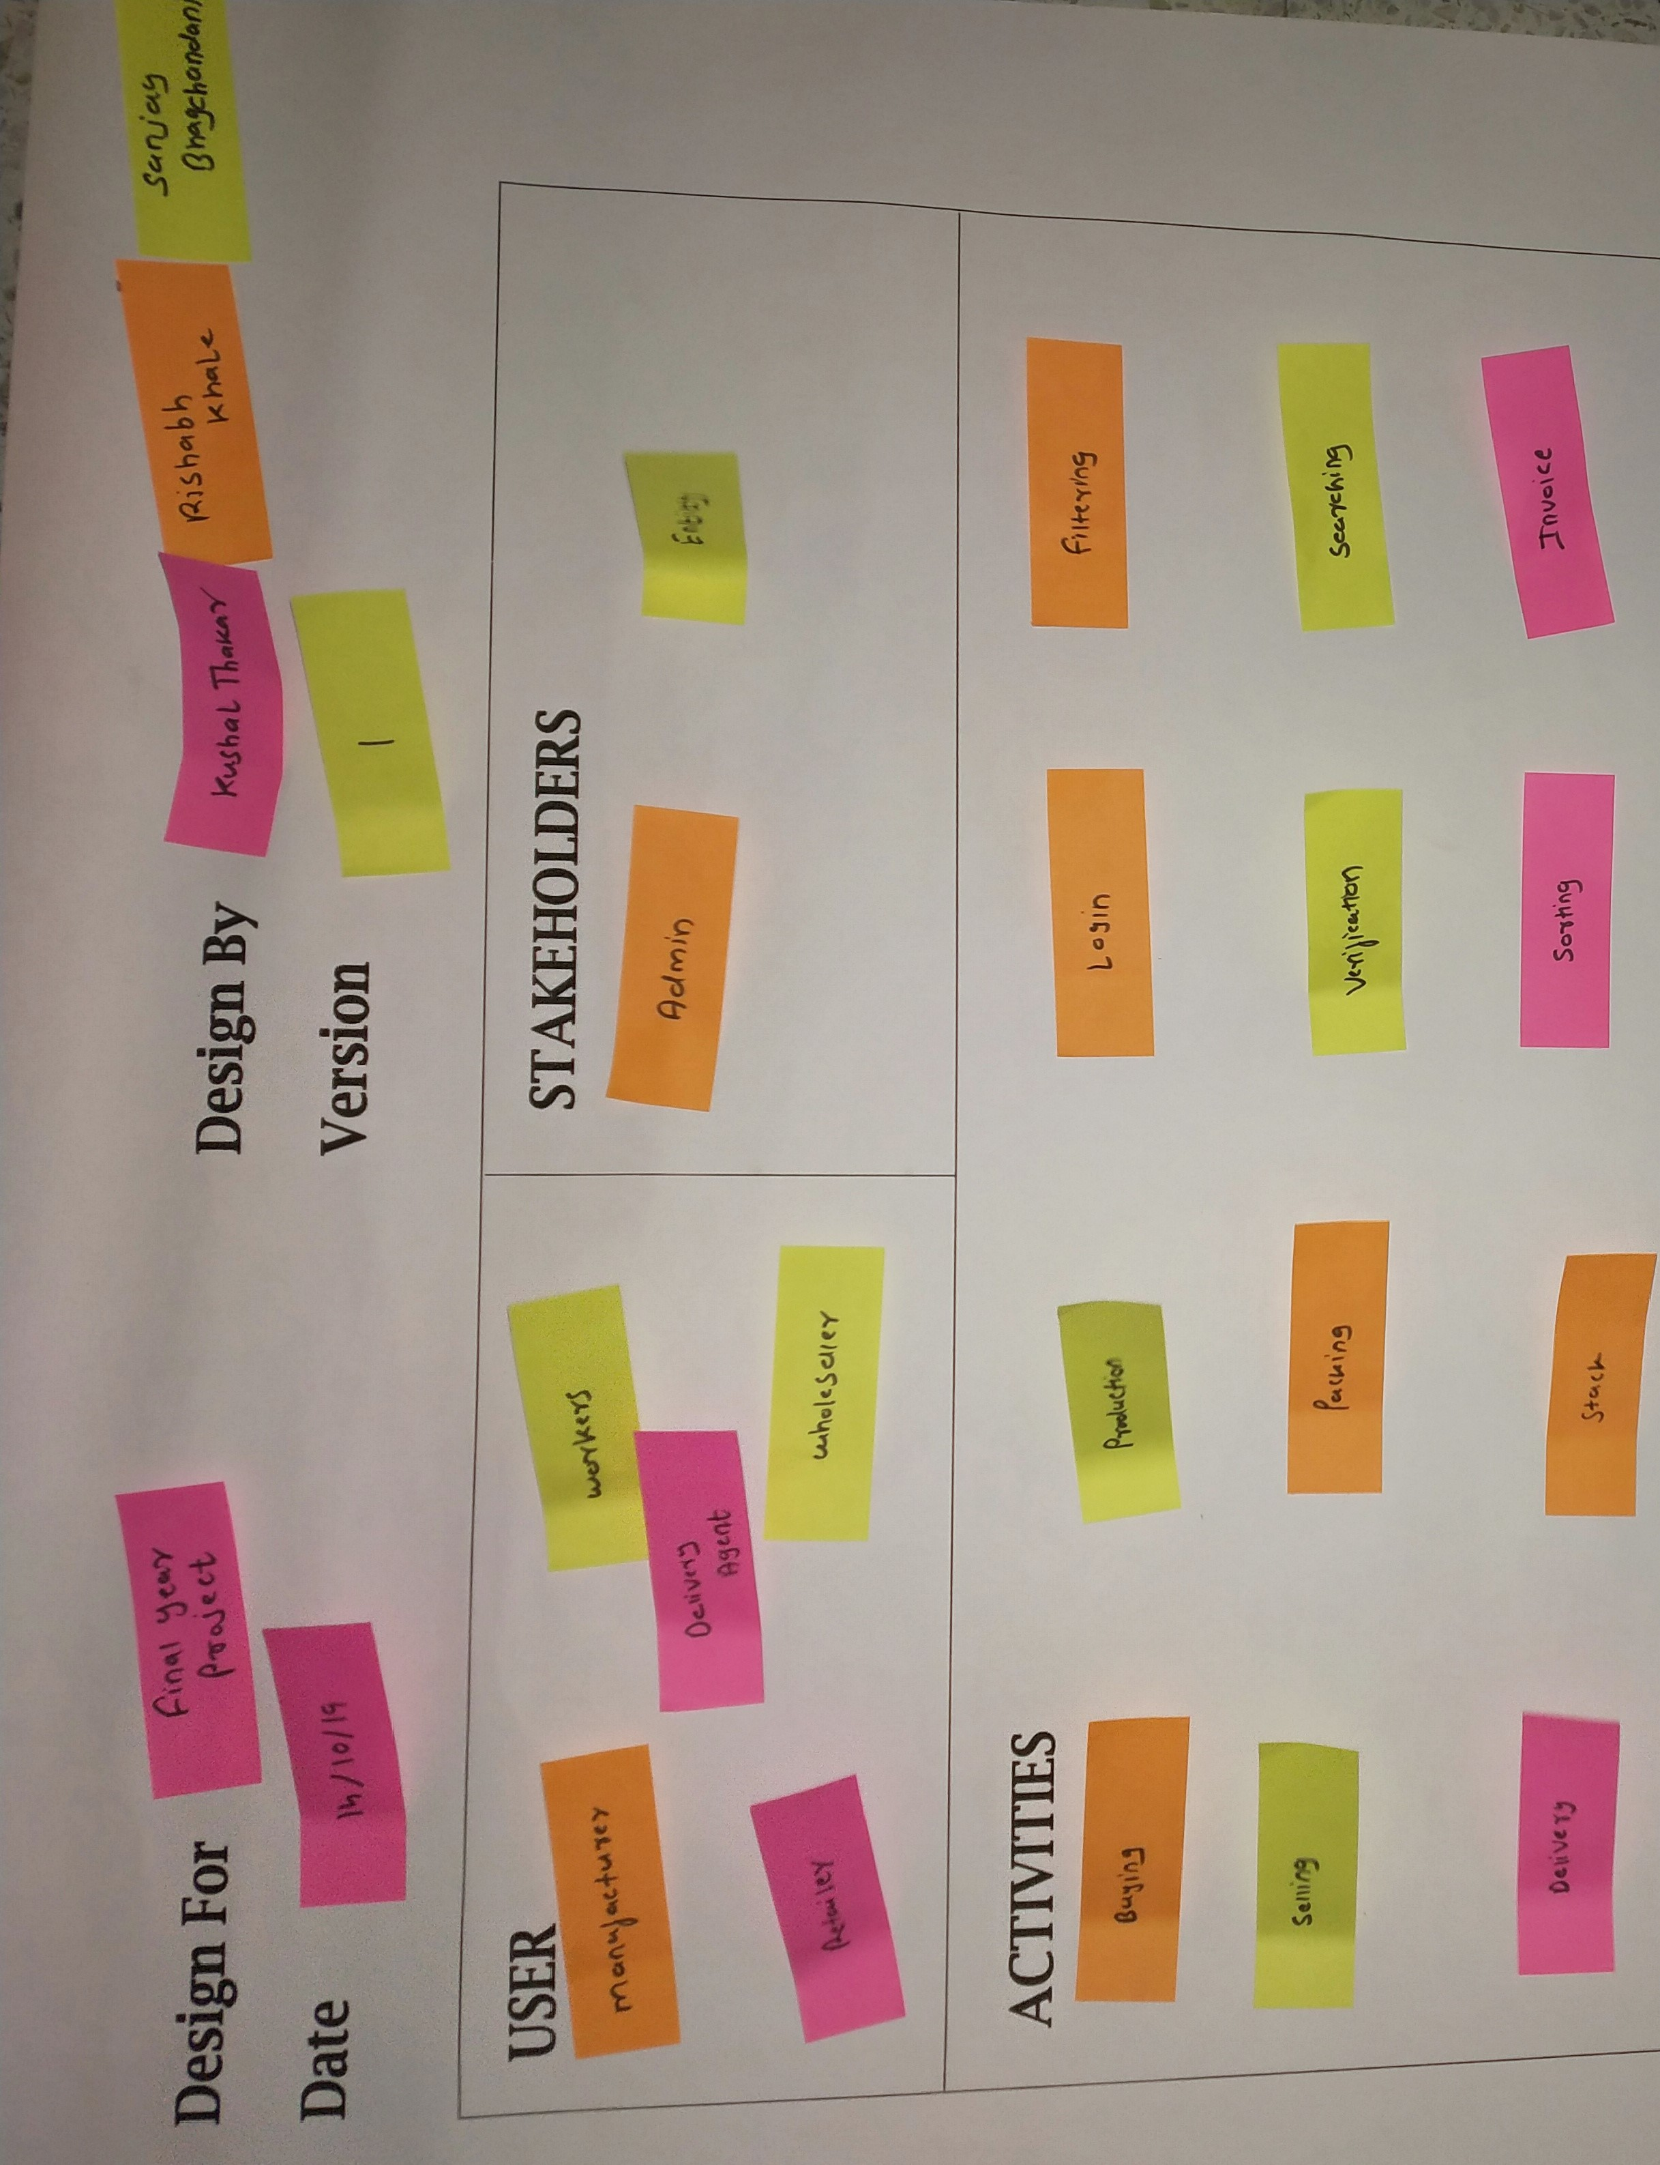
Empathy Canvas

Slide 24
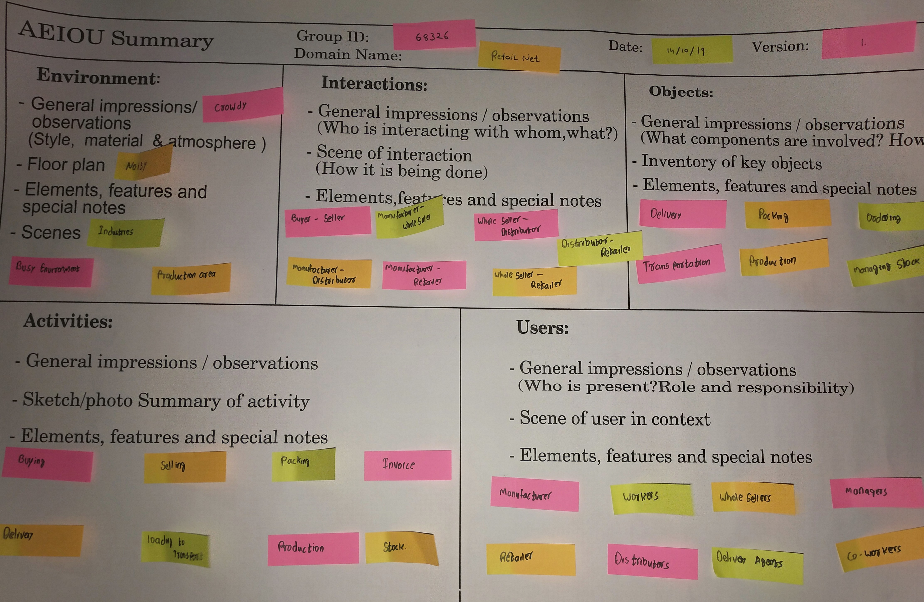
AEIOU Canvas

Slide 25
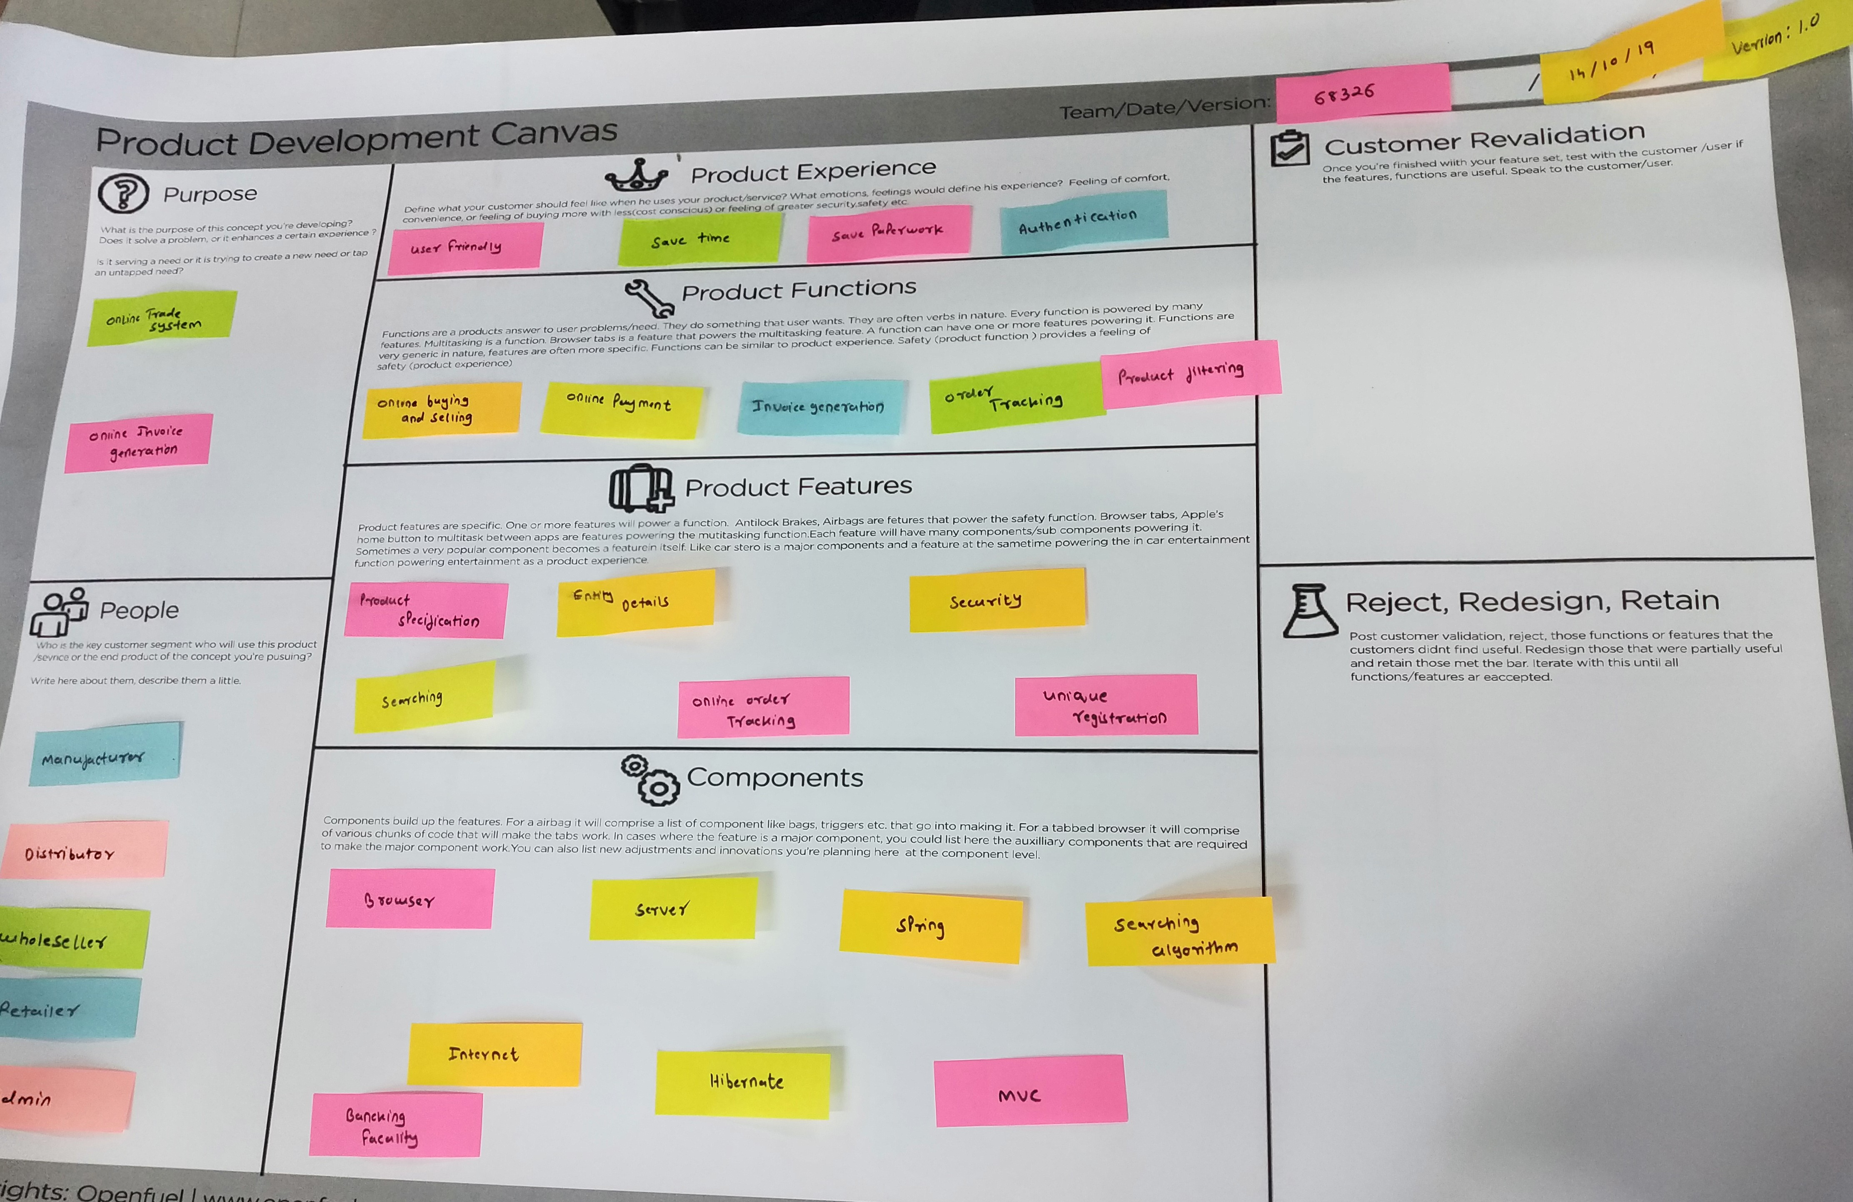
Product Development Canvas

Slide 26
Diagrams

Slide 27
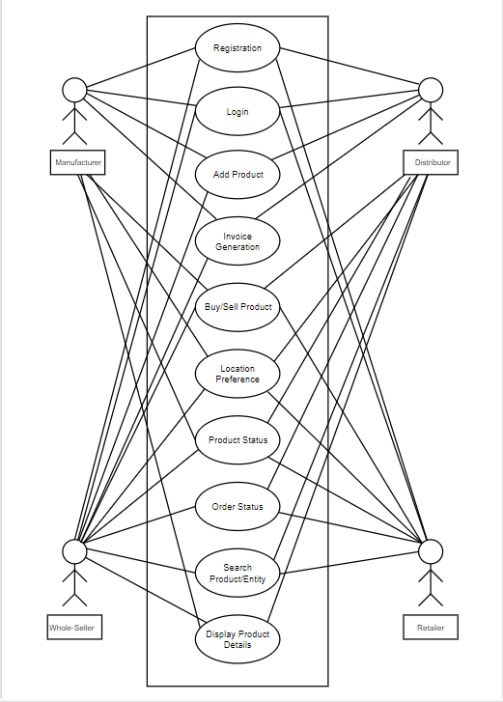
Use-Case Diagram

Slide 28
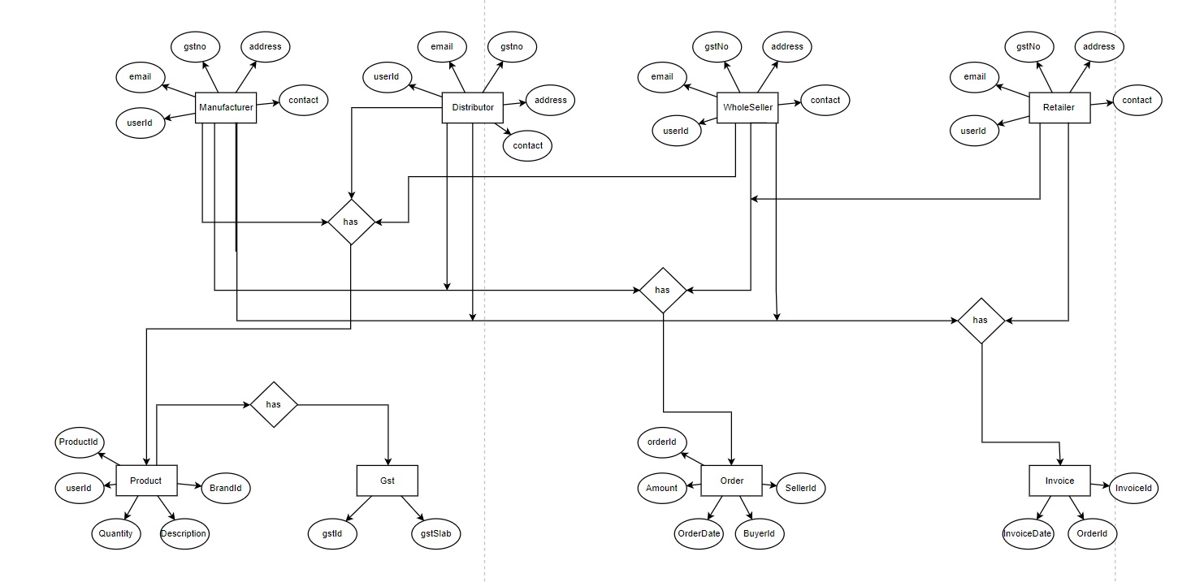
Entity Relation Diagram

Slide 29
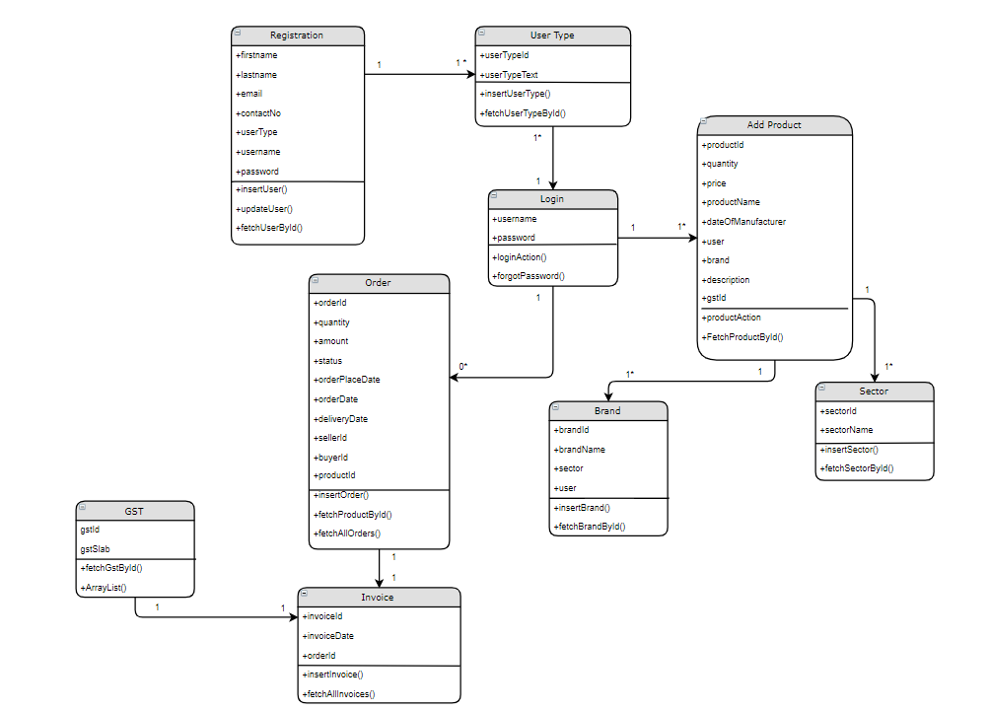
Class Diagram

Slide 30
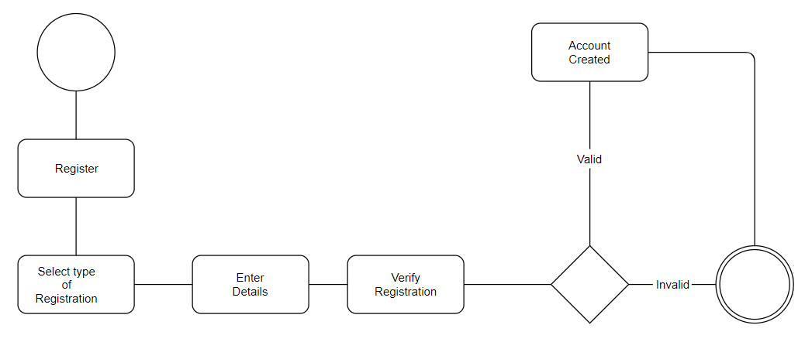
Activity Diagram
Activity Diagram for Registration

Slide 31
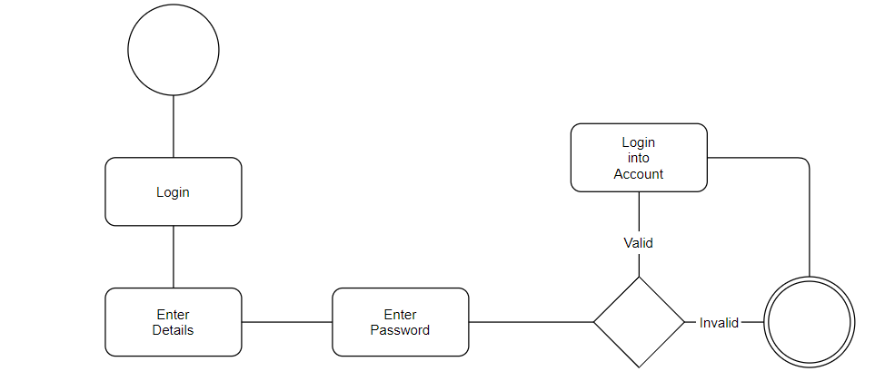
Activity Diagram
Activity Diagram for Login

Slide 32
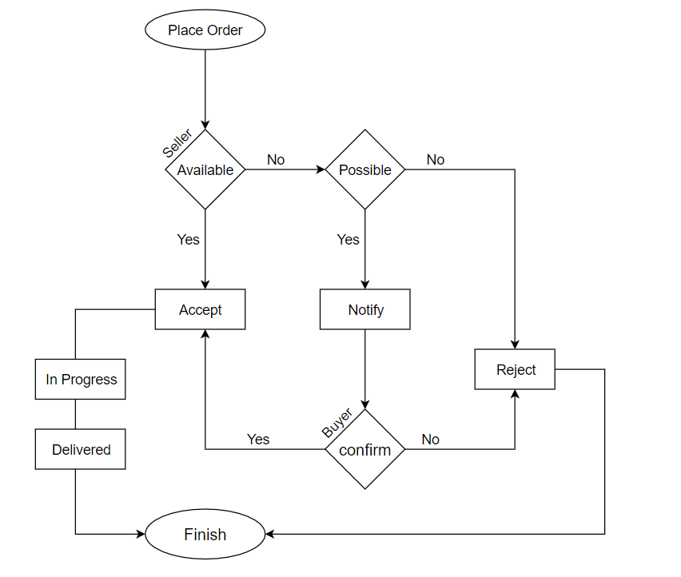
State Diagram
State Diagram for Placing Order

Slide 33
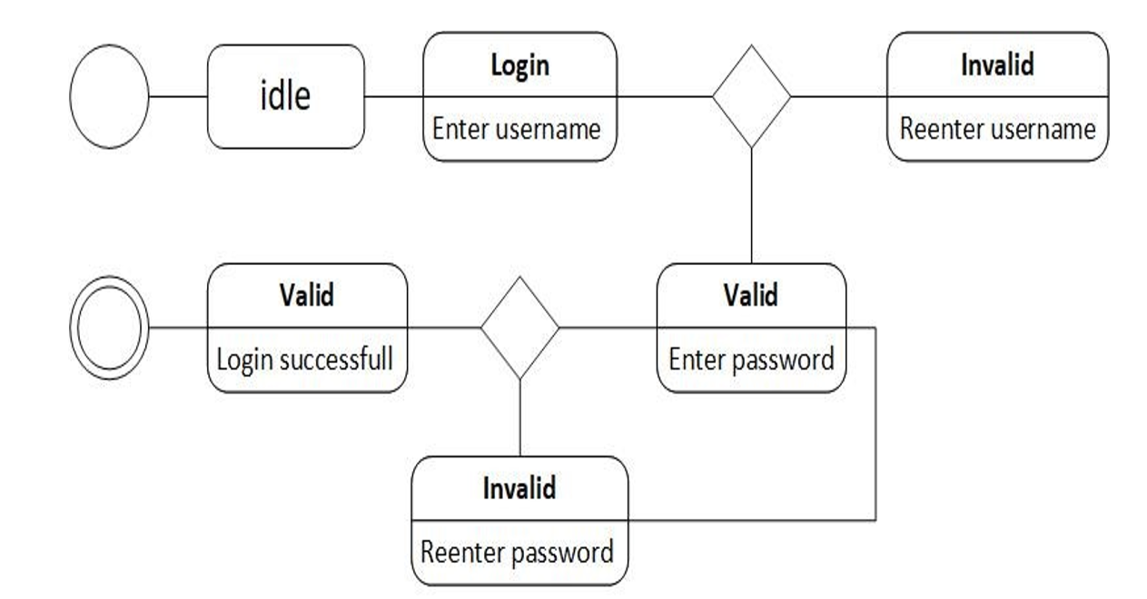
State Diagram
State Diagram for Login

Slide 34
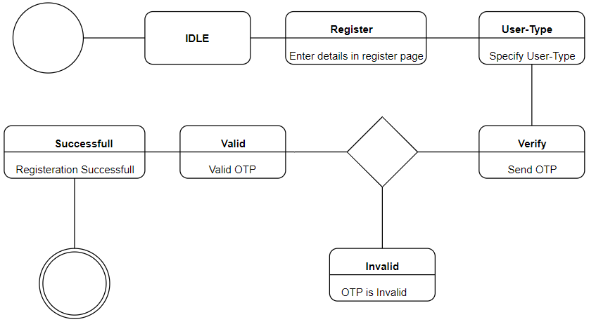
State Diagram
State Diagram for Registration

Slide 35
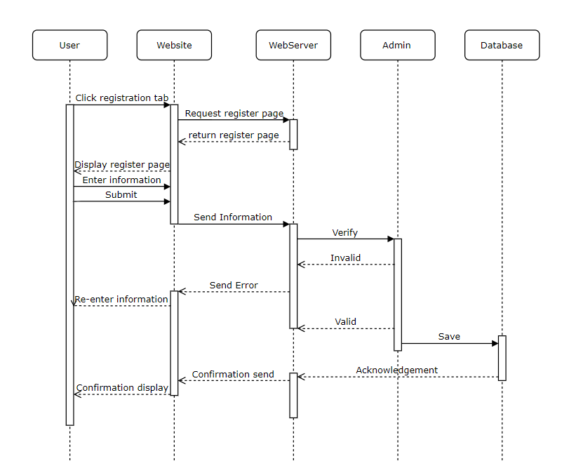
Sequence Diagram
Sequence Diagram for Registration

Slide 36
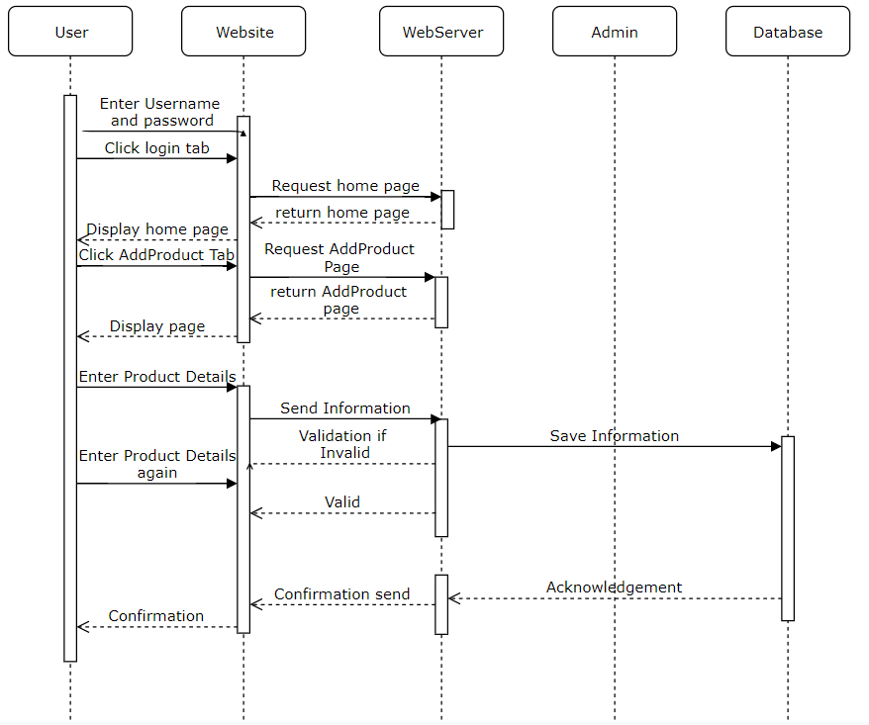
Sequence Diagram
Sequence Diagram for Add Product

Slide 37
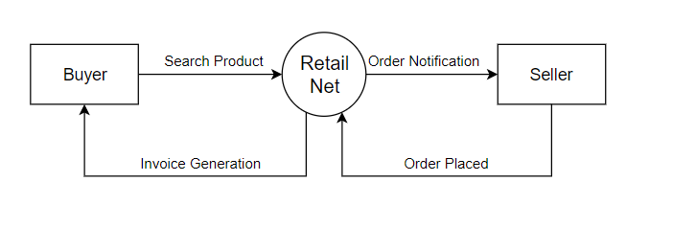
Data Flow Diagram
DFD Level 0

Slide 38
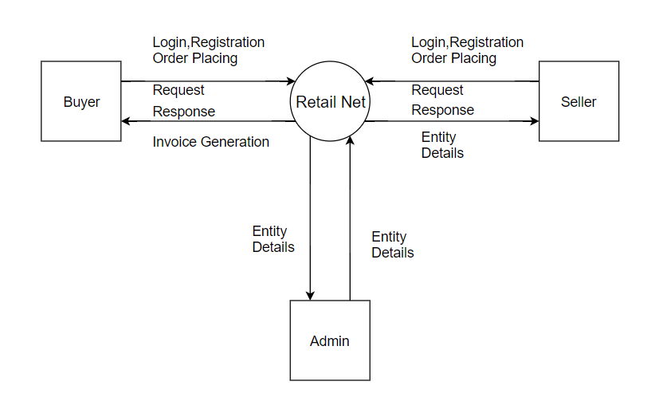
Data Flow Diagram
DFD Level 1

Slide 39
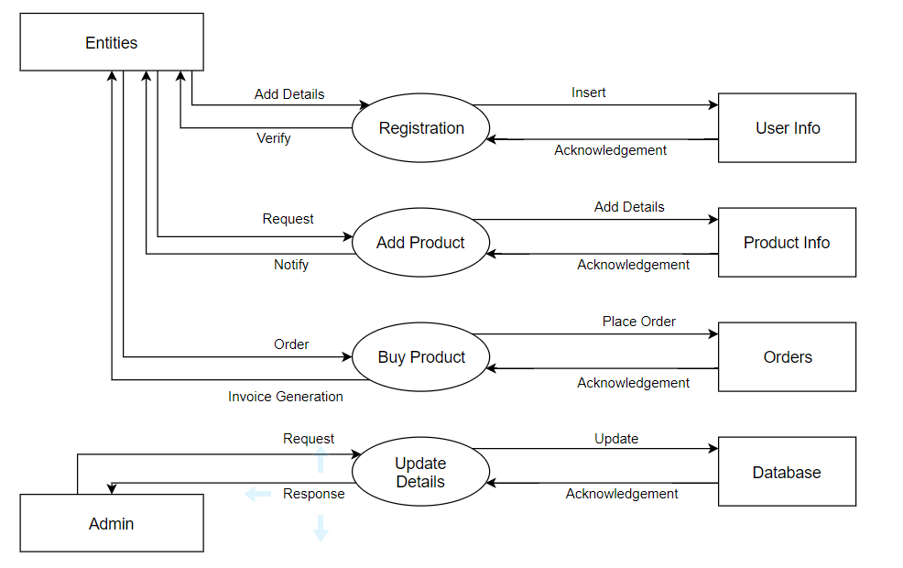
Data Flow Diagram
DFD Level 2

Slide 40
Data Dictionary

Slide 41
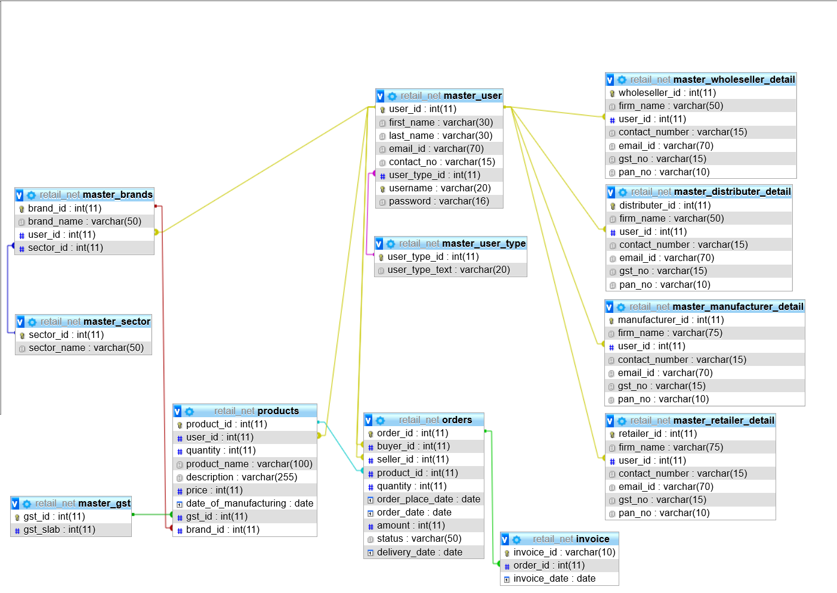
Database Design

Slide 42
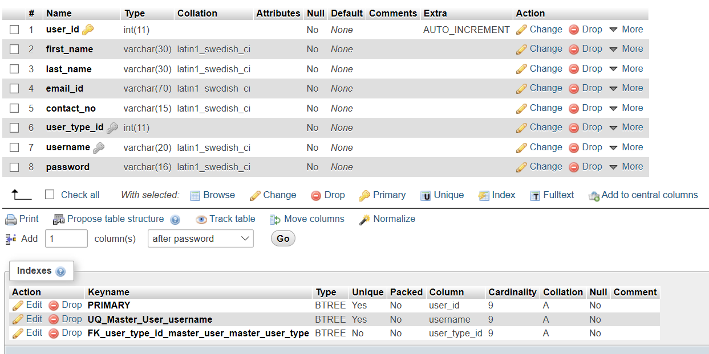
Master_User

Slide 43
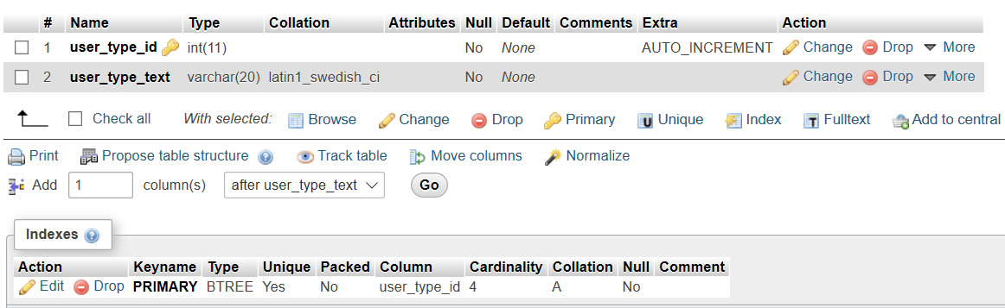
Master_User_Type

Slide 44
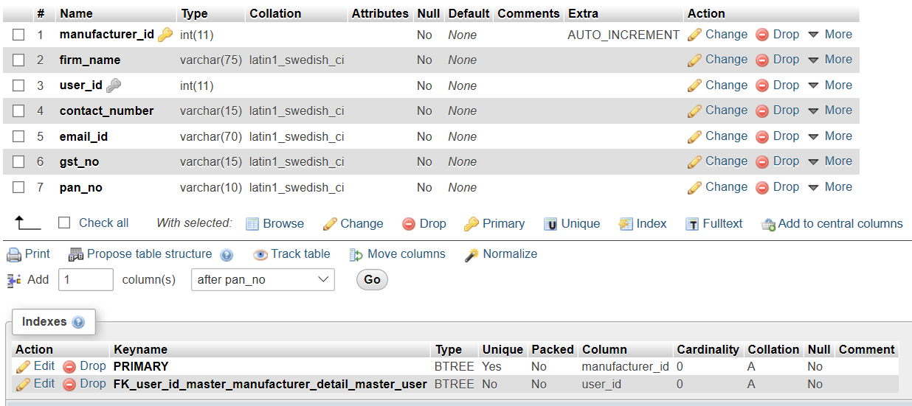
Master_Manufacturer

Slide 45
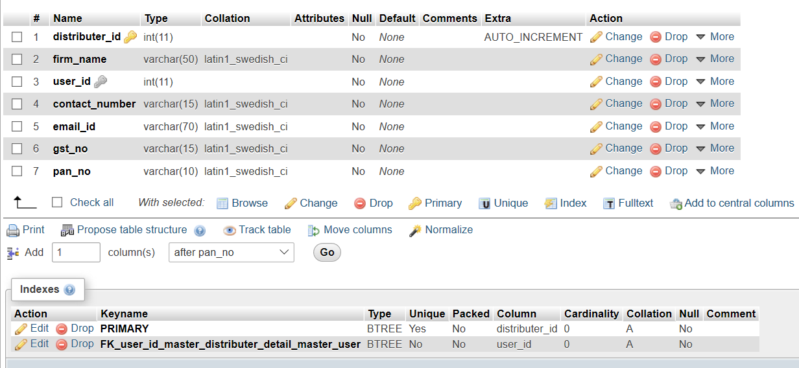
Master_Distributor

Slide 46
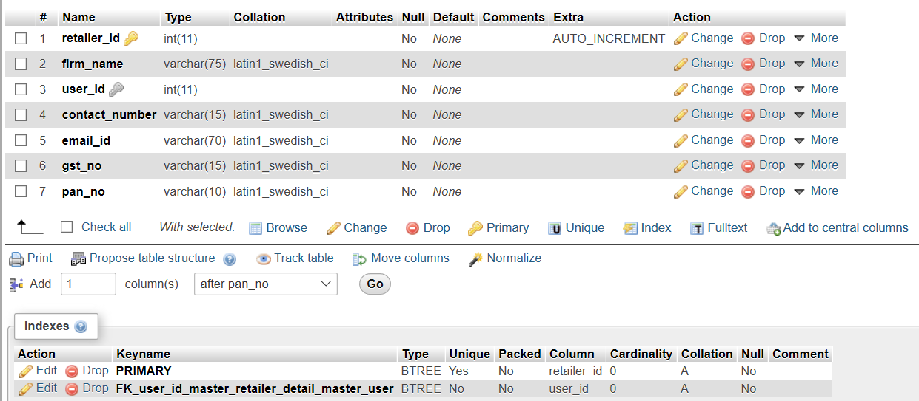
Master_Retailer

Slide 47
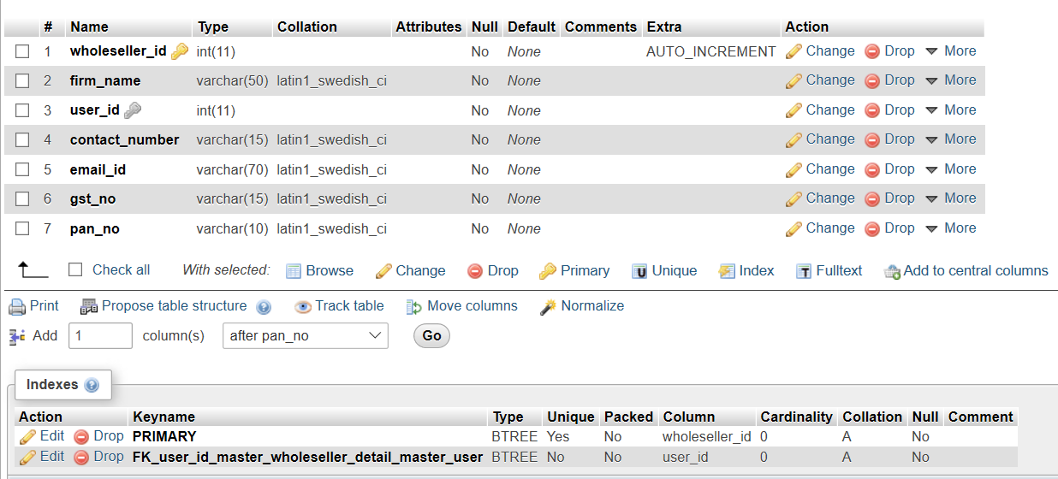
Master_Wholeseller

Slide 48
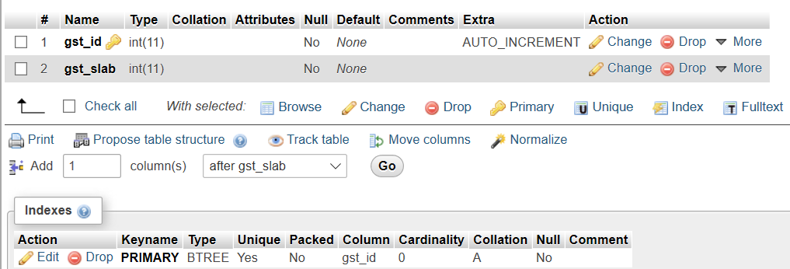
Master_Gst

Slide 49
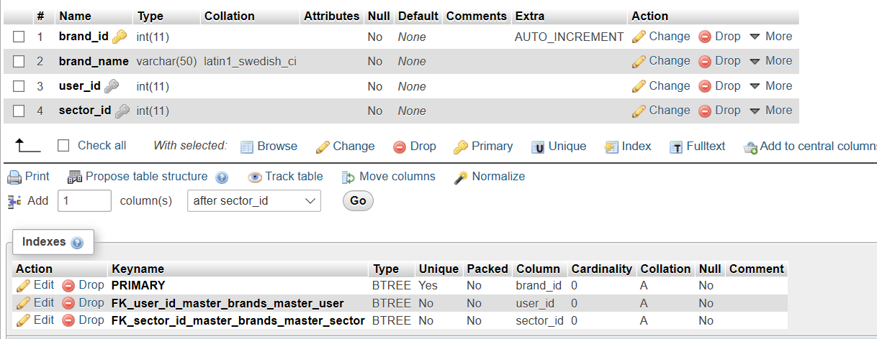
Master_Brands

Slide 50
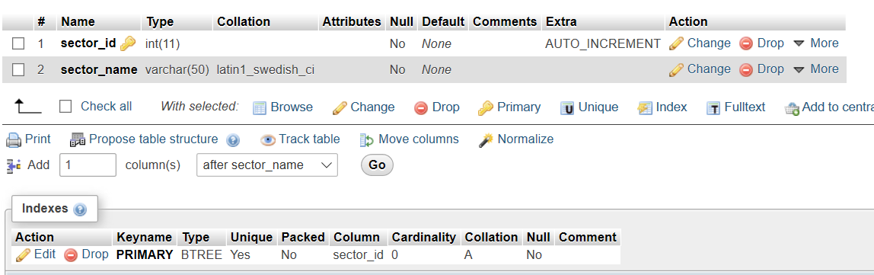
Master_Sectors

Slide 51
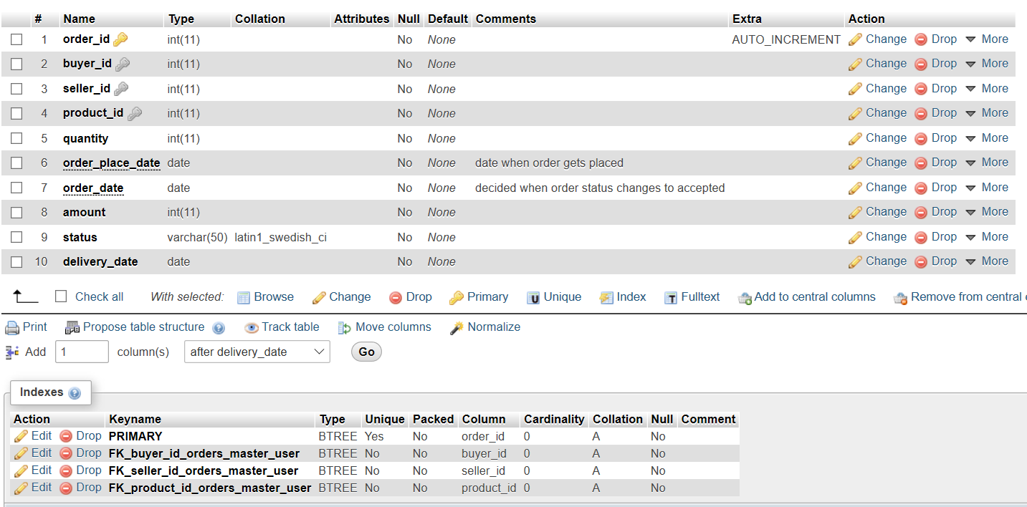
Orders

Slide 52
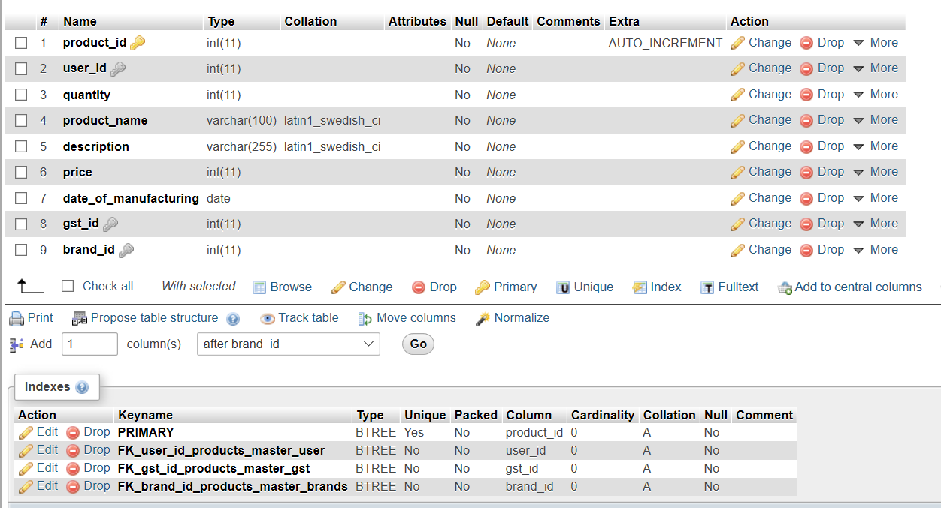
Products

Slide 53
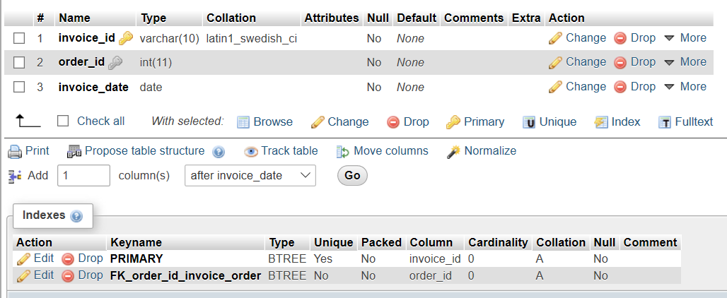
Invoice

Slide 54
Thank You

